Slide 1
Auto-feedback generator
Natural
Language
understanding

Slide 2
Agenda
Introduction
Dataset Information
Base Model Information
Fine-Tuning with LoRA
Evaluation Methods
Project Results and Plots
Structured Output
Conclusion

Slide 3
Introduction
This project aims to enhance automated essay evaluation by fine-tuning a pre-trained Large Language Model (LLM) using Low-Rank Adaptation (LoRA). Automated essay scoring is a challenging Natural Language Understanding (NLU) task that requires models to assess coherence, grammar, relevance, and writing quality—traits typically judged by human evaluators. To address this, we utilize a robust LLM as the Large(DeBERTa V3), capable of deep contextual understanding, and apply LoRA to fine-tune it efficiently on a domain-specific essay dataset.
Our primary objectives are:
To predict essay scores with high accuracy,
To generate personalized, structured feedback for each essay, and
To maintain computational efficiency using parameter-efficient fine-tuning methods.
This project not only demonstrates the effectiveness of LoRA in adapting large models to specialized tasks with minimal overhead but also highlights the importance of structured output in real-world educational applications.

Slide 4
Dataset Information

Slide 5
Overview
Dataset Information
This project uses three complementary datasets to train and evaluate the model for essay scoring and feedback generation:
Persuade 2.0 Dataset
ASAP 2.0 Dataset
Persuade Corpus and Ellipse Corpus Combined Dataset

Slide 6
Dataset Information cont.
ASAP 2.0 Dataset
Structure:
essay_id: Essay Identifier
full_text: full essay text
score: Final score (range from 0 to 6)
assignment: Full prompt or writing assignment text
prompt_name Short name for the prompt
economically_disadvantaged: Whether the student is economically disadvantaged (Yes / No / Other)
student_disability_status: Whether the student is identified as having a disability
ell_status: ELL (English Language Learner) status (Yes / No / Other)
race_ethnicity Race/ethnicity of the student
gender: Gender of the student (M / F)
Source: Kaggle - ASAP 2.0: Automated Student Assessment Prize
Size: The dataset contains 24,728 rows

Slide 7
Dataset Information cont.
Persuade 2.0 Dataset
AES2-persuade
Structure:
essay_id: Essay Identifier
full_text: Full essay text
score: Final holistic score (range from 1 to 6)
prompt_name: Short name for the essay prompt
src: Data source origin
predicted: Boolean indicator of whether a prediction exists (true/false)
prompt_label: Numeric label representing the associated prompt bucket
Source: Kaggle - persuade-2.0
Size: The dataset contains 30,432 rows

Slide 8
Dataset Information cont.
Persuade 2.0 Dataset
persuade_2.0_human_scores_demo_id_github
Structure:
essay_id_comp: Essay identifier
full_text: Full essay text
holistic_essay_score: Holistic score assigned to each essay (range from 1 to 6)
word_count: Word count of the essay
prompt_name: Short name for the prompt
task: Type of essay task (Independent / Text dependent)
assignment: Full writing prompt or assignment text
source_text: Source material used for the prompt
gender: Gender of the student (M / F)
grade_level: Student's grade level
Source: Kaggle - persuade-2.0
Size: The dataset contains 26,000 rows

Slide 9
Dataset Information cont.
Persuade Corpus and Ellipse Corpus Combined Dataset
all_data
Structure:
essay_id: Unique identifier for each essay
full_text: Raw student essay text
holistic_essay_score: Final score given to each essay (range 1.0 to 5.0)
word_count: Number of words in the essay
prompt_name: Name of the assigned writing prompt
annotated_text: Essay text with embedded discourse annotations
discourse_count: Total number of discourse elements in an essay
effective_count: Count of discourse elements marked as "Effective"
adequate_count: Count of discourse elements marked as "Adequate"
Source: Kaggle - PERSUADE Corpus and ELLIPSE Corpus Combined
Size: 118 annotated training essays

Slide 10
Dataset Information cont.
Persuade Corpus and Ellipse Corpus Combined Dataset
holistic_scores
Structure:
essay_id: Unique essay identifier
full_text: Full text of the student essay
holistic_essay_score: Score assigned to each essay (range: 1 to 6)
word_count: Word count of the essay
prompt_name: Name of the essay prompt
Source: Kaggle - PERSUADE Corpus and ELLIPSE Corpus Combined
Size: 11,023 training essays

Slide 11
Dataset Information cont.
Persuade Corpus and Ellipse Corpus Combined Dataset
scores_arguments
Structure:
essay_id: Unique essay identifier
full_text: Full student essay text
holistic_essay_score: Holistic score assigned (range: 1 to 6)
word_count: Word count of the essay
prompt_name: Short name for the essay prompt
annotated_text: Full essay text with discourse annotations
discourse_count: Total number of discourse elements
effective_count: Number of discourse elements labeled as "Effective"
adequate_count: Number of discourse elements labeled as "Adequate"
Source: Kaggle - PERSUADE Corpus and ELLIPSE Corpus Combined
Size: 4,058 training essays

Slide 12
Dataset Information cont.
Persuade Corpus and Ellipse Corpus Combined Dataset
scores_ell
Structure:
essay_id: Unique essay identifier
full_text: Full student essay text
holistic_essay_score: Holistic score (range: 1 to 6)
word_count: Essay length in words
prompt_name: Essay prompt name
cohesion: Logical connectedness of ideas
Syntax: Sentence structure and complexity
vocabulary: Word choice variety and precision
phraseology: Use of idiomatic and academic expressions
• Source: : Kaggle - PERSUADE Corpus and ELLIPSE Corpus Combined
• Size: 334 training essays

Slide 13
Dataset Information cont.
The preprocessing pipeline begins by importing and loading multiple datasets from various sources, including ASAP 2.0 and several files from the Persuade 2.0 corpus and its extended versions. Initially, these datasets are standardized by renaming the column "holistic_essay_score" to "score" where necessary. The selected columns, "full_text" and "score," are then extracted and combined into a unified DataFrame.
To normalize the scoring range across different sources, MinMax scaling is applied to the main combined dataset as well as to a specific subset (df4) before it is merged. Afterward, the full dataset is cleaned by removing duplicates and any rows containing missing or empty essay texts.
The essays are then shuffled to randomize their order before being processed through a cleaning function. This function lowercases the text, removes HTML tags and URLs, filters out non-alphanumeric characters (excluding certain punctuation), and removes excess whitespace. Additionally, essays with fewer than 30 words are filtered out to ensure quality.
A minor manual correction is applied to the scores, replacing any instance of 0.25 with 0.20 to address a potential outlier issue.

Slide 14
Dataset Information cont.
We performed data augmentation by paraphrasing essays with underrepresented scores using a pretrained model, followed by the same preprocessing steps applied earlier.
To balance the dataset, we resample all groups to match the size of the smallest group, which has 1.0 samples. This size becomes our target. Each group is then adjusted to have the same number of samples as the target. If a group has fewer samples than the target, we increase its size by upsampling with replacement. Conversely, if a group exceeds the target size, we reduce its size through downsampling. After resampling, we combine all the groups into a single balanced dataset, ensuring equal representation from each group. This method eliminates bias from the dataset, leading to more accurate and fair analysis or model training.

Slide 15
Base Model Information

Slide 16
Overview
Base Model Information
We use DeBERTa-V3-large, a powerful transformer-based language model developed by Microsoft, as the foundation for our essay scoring system. DeBERTa (Decoding-enhanced BERT with disentangled attention) improves on BERT and RoBERTa by introducing disentangled representations of content and position, along with an enhanced mask decoder. With 435 million parameters, 24 layers, and a hidden size of 1024, DeBERTa-V3-large achieves state-of-the-art results on a range of natural language understanding tasks, making it well-suited for fine-tuning in educational NLP applications.

Slide 17
Base Model Information cont.
Architecture:
Type: Transformer-based encoder model
Layers: 24 Transformer layers
Hidden Size: 1024
Attention Heads: 16
Total Parameters: ~1.5 Billion
Tokenizer: WordPiece-based with sentencepiece model
Max Sequence Length: 512 tokens
Key Innovations:
Disentangled Attention Mechanism
Separates content and position embeddings for better context understanding
Enhanced Mask Decoder
Improves generalization and downstream task performance
Pre-trained with MLM Objective
Trained on massive English corpora (Books, Wikipedia, CC-News, etc.)
Capabilities:
Deep understanding of language semantics
Superior performance in NLU benchmarks
Effective zero-shot and few-shot reasoning
Strong base for fine-tuning on regression/classification tasks

Slide 18
Fine-Tuning with LoRA

Slide 19
Lora Overview
Fine-Tuning with LoRA
Low-Rank Adaptation (LoRA) is a parameter-efficient fine-tuning technique designed to adapt large pre-trained language models without updating all of their parameters. Instead of modifying the entire model, LoRA introduces small, trainable rank-decomposition matrices into each layer of the model’s attention mechanism. This drastically reduces the number of trainable parameters, making the fine-tuning process faster, more memory-efficient, and less prone to overfitting, especially beneficial when computational resources or data are limited.

Slide 20
Fine-Tuning with LoRA cont.
In our code, we fine-tuned a DeBERTa v3 model for essay score regression using LoRA with the peft library. We started by loading the Large DeBERTa model and then added LoRA adapters by wrapping it with get_peft_model, targeting the query , key projection and value projection layers in the self-attention modules.
We used LoraConfig with r=16, alpha=32, and task_type="FEATURE_EXTRACTION" to make it suitable for regression. The rest of the model remained frozen; only the LoRA parameters were trained.
we implemented a custom training loop in PyTorch. The DebertaRegressor class extracts mean-pooled token embeddings from the model and passes them through a linear regression head to predict a score. During training, we compute a mean squared error loss.
We also handled text preprocessing, tokenization, and dataset loading manually using a custom EssayDataset class, and we used multiple sources (ASAP, Persuade 2.0, etc) for robust training.
This setup allowed us to efficiently fine-tune the model with LoRA while keeping memory usage low and training time fast without modifying the full DeBERTa parameters.

Slide 21
Evaluation Methods

Slide 22
Evaluation Methods
Mean Squared Error (MSE): Measures the average of the squared differences between predicted and actual scores. Lower MSE indicates better performance.
Mean Absolute Error (MAE): Captures the average absolute difference between predicted and true scores. It’s a more interpretable measure in the context of human-like scoring.
R² Score (Coefficient of Determination): Tells us how much of the variance in essay scores our model can explain. Higher values (closer to 1) indicate stronger predictive power.

Slide 23
Evaluation Methods cont.
To evaluate our model’s performance on essay score regression, we used three main metrics: Mean Squared Error (MSE), Mean Absolute Error (MAE), and R² Score. We applied these metrics both before fine-tuning and after applying LoRA-based fine-tuning to monitor performance improvements.
we implemented a custom evaluate function to compute metrics on a validation set and tracked these metrics epoch-by-epoch using our train_epoch loop.
This combination of custom evaluation and comprehensive metrics provided a well-rounded assessment of our model’s accuracy and fairness.

Slide 24
Evaluation Methods cont.
METRIC | Before | After
MSE | 0.134 | 0.015
MAE | 0.315 | 0.084
R2 | -0.15 | 0.869
This table compares the evaluation metrics of the Large DeBERTa model and the LoRA fine-tuned model.
It highlights how fine-tuning with LoRA led to significant improvements in prediction accuracy and overall performance.

Slide 25
Project Results and Plots

Slide 26
Overview
Project
Results and Plots
For our project results, we performed a comparative analysis between the Large DeBERTa model and the LoRA fine-tuned version. Quantitatively, we observed clear improvements across all evaluation metrics MSE, MAE, and R² after applying LoRA.
The fine-tuned model produced lower error values and significantly better score alignment, demonstrating its improved ability to capture the nuances of essay quality.

Slide 27
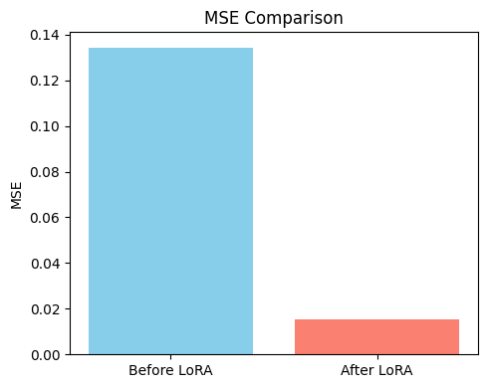
Project
Results and Plots
The graph shows how much our model improved after applying LoRA. On the left, the "Before LoRA" bar represents the MSE when we only used the DeBERTa model without any fine-tuning.
It was pretty high, around 0.134, meaning the model’s predictions were quite far off from the actual scores. After we fine-tuned just the LoRA parameters, shown by the "After LoRA" bar on the right, the MSE dropped drastically to 0.015
That sharp decrease shows how effective LoRA was in helping the model adapt to the essay scoring task without needing to retrain the whole model. It’s a clear indicator that fine-tuning even a small set of parameters with LoRA made a huge difference in prediction accuracy.

Slide 28
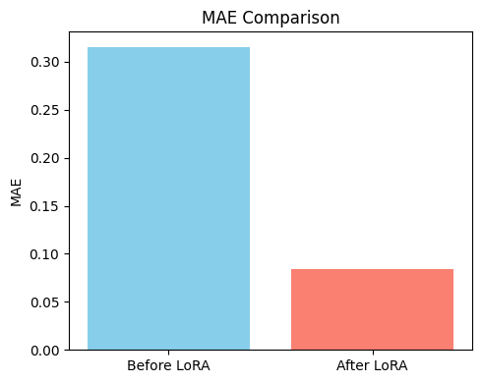
Project
Results and Plots
The graph clearly shows how much our model improved after applying LoRA, this time using the MAE metric. On the left, the "Before LoRA" bar represents the Mean Absolute Error when we used the DeBERTa model without any fine-tuning.
The error was quite high, around 0.315 which means the model’s predicted essay scores were often far from the actual scores. After fine-tuning just the LoRA parameters, as shown by the "After LoRA" bar on the right, the MAE dropped significantly to 0.084.
This sharp reduction highlights how effective LoRA was at improving the model’s scoring consistency and reliability, without the need to retrain the entire model.
It proves that even minimal parameter updates through LoRA can lead to substantial performance gains.

Slide 29
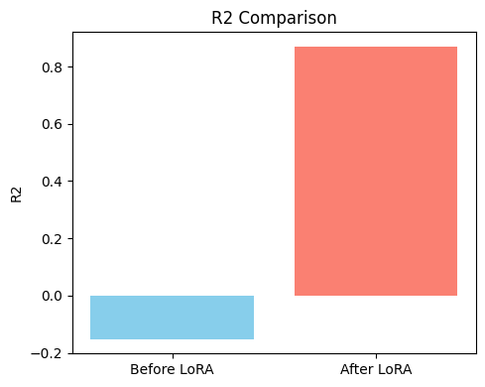
Project
Results and Plots
This graph highlights how much better our model got at explaining the variation in essay scores after applying LoRA.
The "Before LoRA" bar shows the R² score of the DeBERTa model, which was deeply negative around -0.151. That negative value means the model was doing worse than a simple average baseline, clearly struggling to learn anything useful. But after fine-tuning with LoRA, the R² score jumped to about 0.869.
This is a massive improvement, indicating that the fine-tuned model could now explain over 86% of the variance in essay scores.
It’s strong evidence that LoRA helped the model truly understand the underlying scoring patterns without needing to update the entire network.

Slide 30
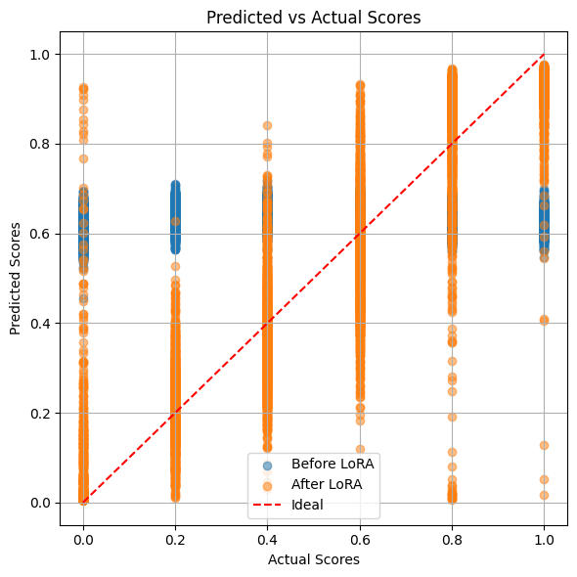
Project
Results and Plots
This scatter plot gives a clear visual of how our model's predictions aligned with the actual essay scores before and after applying LoRA.
The red dashed line represents the ideal scenario where predicted scores perfectly match the actual ones.
The blue dots (Before LoRA) are scattered far below and above the ideal line, showing that the DeBERTa model struggled to predict scores accurately, often underestimating them.
After we fine-tuned using LoRA, shown by the orange dots, the predictions clustered much more tightly around the ideal line. This means the LoRA-tuned model was much better at generating accurate, human-like score predictions.
The plot highlights how much more aligned and reliable the model became thanks to LoRA.

Slide 31
conclusion
In conclusion, our project successfully demonstrated how LoRA fine-tuning can significantly improve the performance of a large pre-trained language model like DeBERTa on the task of automated essay scoring. By selectively training only a small number of parameters, we achieved remarkable gains in accuracy and generalization, as evidenced by the sharp reductions in MSE and MAE and a dramatic improvement in R².
The visual comparisons before and after LoRA tuning clearly show how the model's predictions became more aligned with actual scores, proving the effectiveness of parameter-efficient fine-tuning.
Overall, our results highlight not only the practicality of LoRA in low-resource settings but also its potential for enhancing fairness and reliability in educational NLU applications.

Slide 32
Thank you

